Slide 1
The three chemical bonds, the three intermolecular interactions
and the one mix between the two

Slide 2
the three
chemical
bonds
metallic bonds
covalent bonds ~ 400 kJ/mol
ionic bonds ~ 400 kJ/mol
polar-covalent bonds ~ 400 kJ/mol
visible light 170-290 kJ/mol
ion-dipole 50-200 kJ/mol
heavy main group dispersion 5-100 kJ/mol
FH…H hydrogen bonds ~150 kJ/mol
OH…H hydrogen bonds ~ 20 kJ/mol
NH…H hydrogen bonds ~10 kJ/mol
room temperature 2.5 kJ/mol
dipole-dipole 1-5 kJ/mol
light main group dispersion < 1 kj/mol

Slide 3
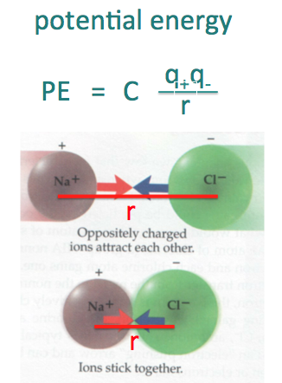
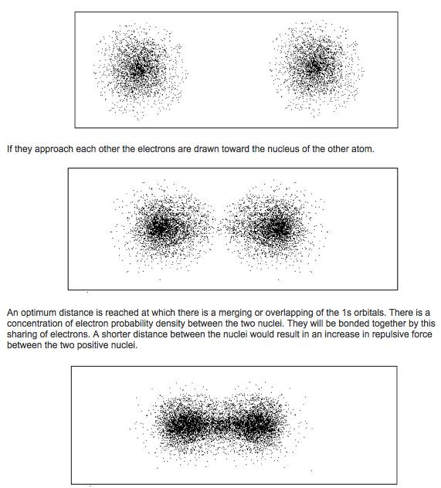
ionic bonds
covalent bonds
Li⁺ + F⁻ → LiF
H + H → H-H
cations and anions
coming together
makes the ionic
bond
electron waves
changing shape
makes the
covalent bond
strong ionic
and covalent
bonds are
both ~ 400
kJ/mole

Slide 4
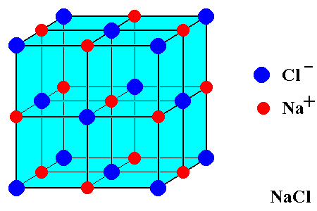
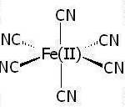
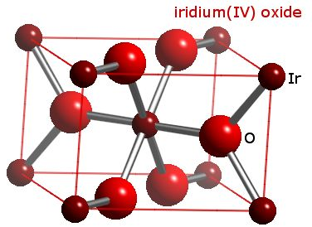
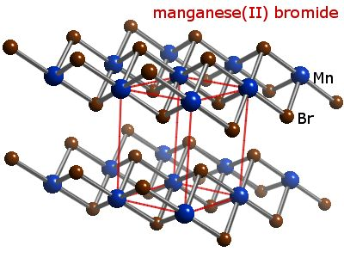
Metal atoms often have ionic bonds and are often in octahedra. Octahedral geometry keeps the minus charges away from one another.
none of the above are metallic bonds: metallic bonds are between two metal atoms.

Slide 5
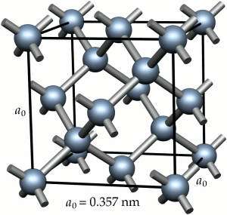
a covalent solid
carbon structure
(diamond)
How many bonds does
a neutral carbon atom
make?

Slide 6
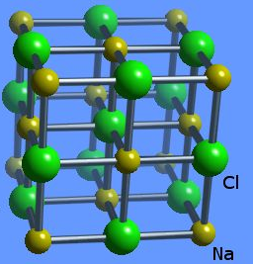
ionic and covalent bonds
~400 kJ/mole
~400 kJ/mole
ionic bonds
table salt, NaCl
covalent bonds
diamond, carbon

Slide 7
We need way to decide whether a compound
is more covalent or more ionic bonding.
Mooser-Pearson diagram

Slide 8
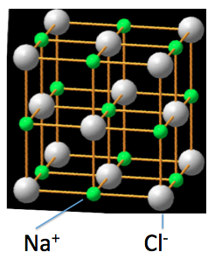
The two Mooser-Pearson structures
C
ionic table (rock) salt structure
covalent diamond structure

Slide 9
Mooser-Pearson diagram
element row matters
electronegativity difference matters

Slide 10
Mooser-Pearson diagram gives the separation of ionic and
covalent bonding.
1) Second row main group
elements make covalent bonds.
2) For row 4 and higher main
group compounds, if the
difference of electronegativity
(Δχ) is less than one then bond
more covalent than ionic.
3) For row 4 and higher If Δχ
is greater than one then bond
is more ionic than covalent.
4) For row 2 ½ ionic/covalent
cut-off is Δχ of 1.5 – 2.0
Mooser-Pearson diagram
Review

Slide 11
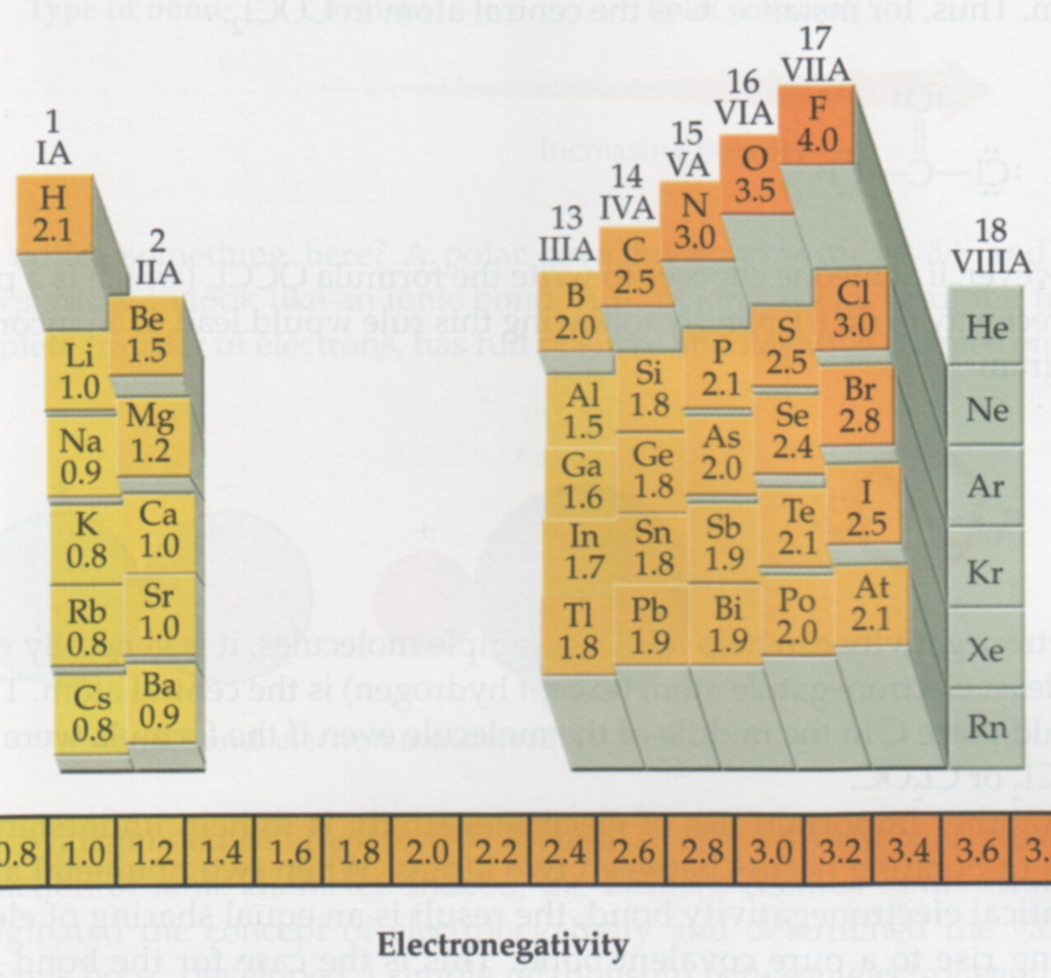

Slide 12
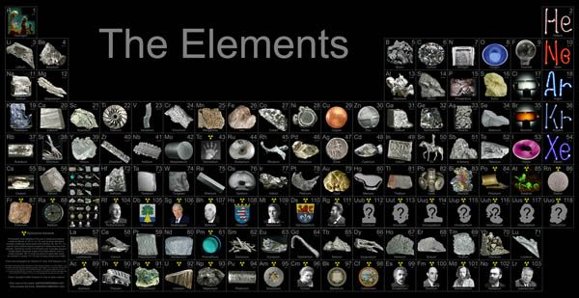
what about metals?

Slide 13
what about metals?
Al
Ga
Sn
Pb
Bi
Po

Slide 14
Metals share their electrons with other metals without
obeying octet rule.
Metals share electrons with as many other atoms as possible.

Slide 15
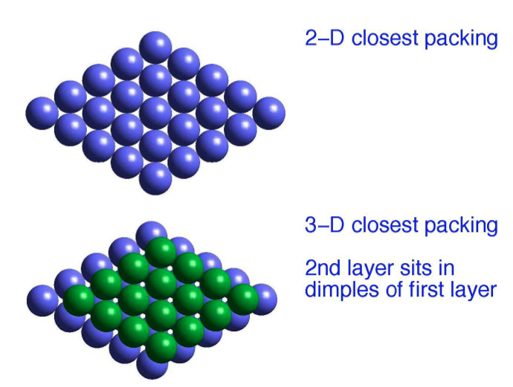
Metals share their electrons with other metals without
obeying octet rule.

Slide 16
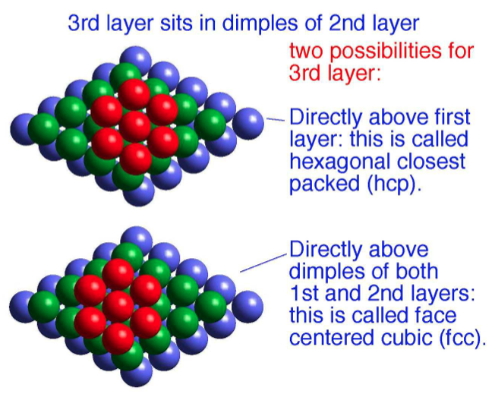

Slide 17
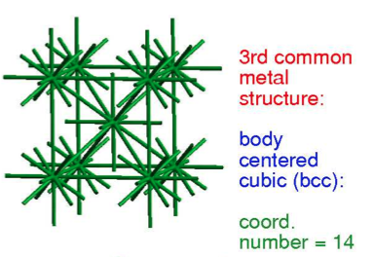

Slide 18
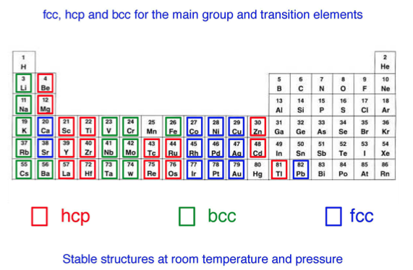

Slide 19
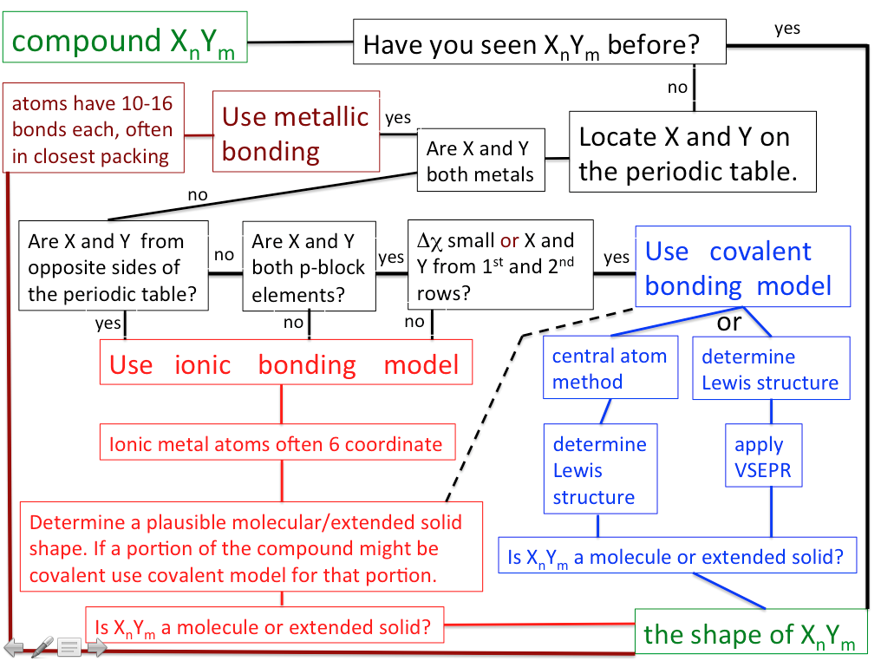
Mooser-Pearson

Slide 20
CaO is added to SiO₂ to make Portland cement. What is CaO's molecular shape?
Mooser-Pearson

Slide 21
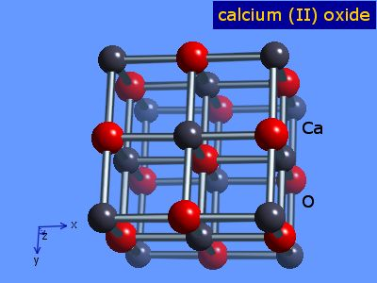

Slide 22
Sodium azide, NaN₃, is the explosive used in air bags. What is its molecular shape?
Mooser-Pearson

Slide 23
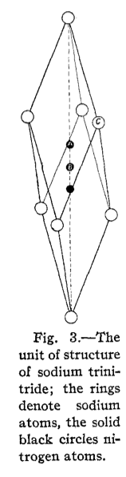
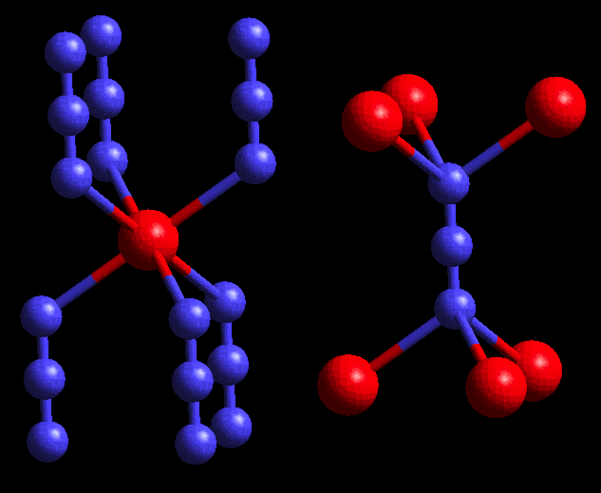
Sterling Hendricks and Linus Pauling 1925
N₃⁻
Na

Slide 24
What is the molecular shape of bronze (the alloy of copper and tin)?
Mooser-Pearson

Slide 25
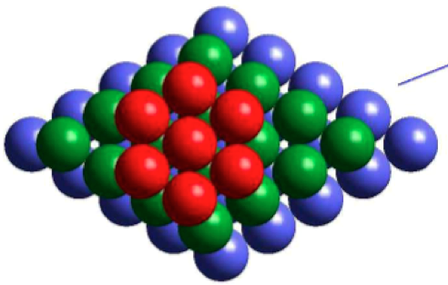
bronze forms the fcc (face-centered-cubic) structure
with random occupation of Cu and Sn atoms

Slide 26
Sand is primarily SiO₂. What is the molecular shape of SiO₂? (no multiple bonds in SiO₂)
Mooser-Pearson

Slide 27
Mooser-Pearson diagram
SiO₂
SiO₂ is on the borderline
between ionic and covalent

Slide 28
if covalent
if SiO₂ is covalent then neutral Si makes four bonds and neutral O
makes two bonds. As Si is not 2nd row, assume no multiple bonds
between Si and O.
Glass and quartz are SiO₂. Don't be surprised if SiO₂ is an extended
solid (in which case we only need to draw a piece with two Si atoms
and 6-8 O atoms).
if ionic
if SiO₂ is ionic, then Si probably makes six bonds. O will then need to
make three bonds. It looks like in this case it is also an extended solid.
answer on prelim will not be considered wrong
if you produce a good molecular covalent SiO₂.

Slide 29
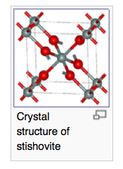
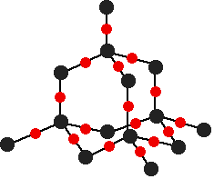
covalent SiO₂
ionic SiO₂
Si
Si
O
O
Crystal
structure
of α-quartz
the rare and dense
form of SiO₂,
stishovite, found
in meteors
the common form of
SiO₂ found in glass
(imperfect) and quartz

Slide 30
What are the molecular shapes of SiS₂ vs. SnS₂?
Mooser-Pearson

Slide 31
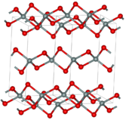
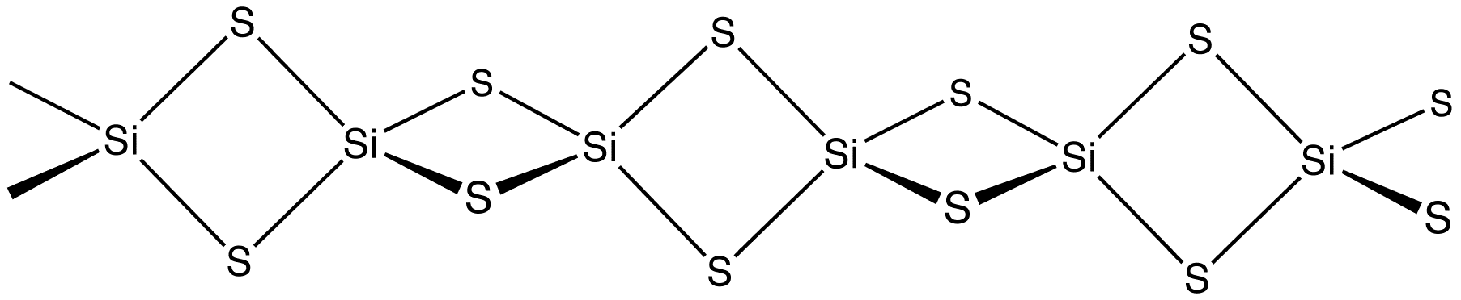
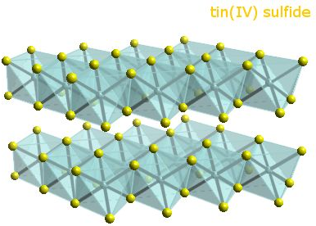
SiS₂ structure
SnS₂ structure

Slide 32
the three intermolecular interactions

Slide 33
metallic bonds
covalent bonds ~ 400 kJ/mol
ionic bonds ~ 400 kJ/mol
polar-covalent bonds ~ 400 kJ/mol
visible light 170-290 kJ/mol
ion-dipole 50-200 kJ/mol
heavy main group dispersion 5-100 kJ/mol
FH…H hydrogen bonds ~150 kJ/mol
OH…H hydrogen bonds ~ 20 kJ/mol
NH…H hydrogen bonds ~10 kJ/mol
room temperature 2.5 kJ/mol
dipole-dipole interactions 1-5 kJ/mol
light main group dispersion < 1 kj/mol
the three
intermolecular
interactions

Slide 34
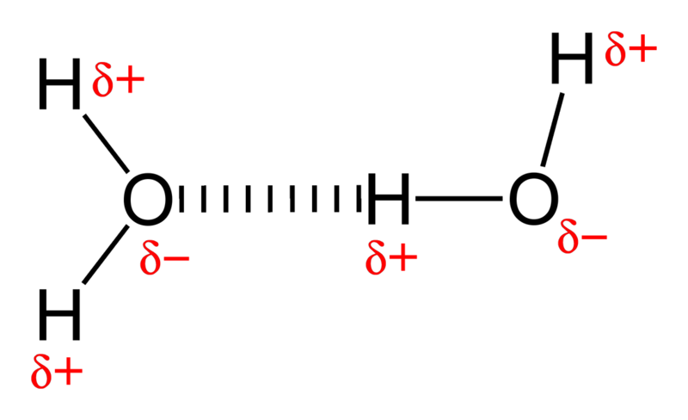
the hydrogen bond
Mooser-Pearson diagram
F−H…:F (160 kJ/mol)
O−H…:O (20 kJ/mol)
N−H…:N (10 kJ/mol)
Region where the ionic
hydrogen bond occurs

Slide 35
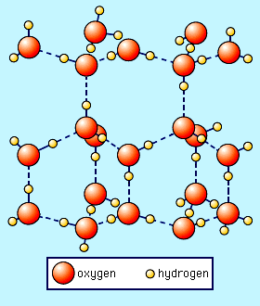
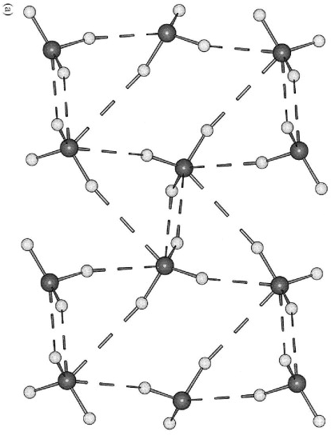
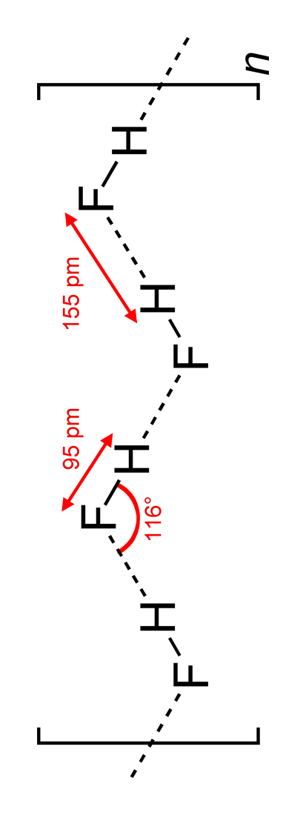
the hydrogen bond
F−H…:F (160 kJ/mol) O−H…:O (20 kJ/mol) N−H…:N (10 kJ/mol)
room temperature 2.5 kJ/mol
HF room temperature liquid H₂O: liquid NH₃: room temperature gas

Slide 36
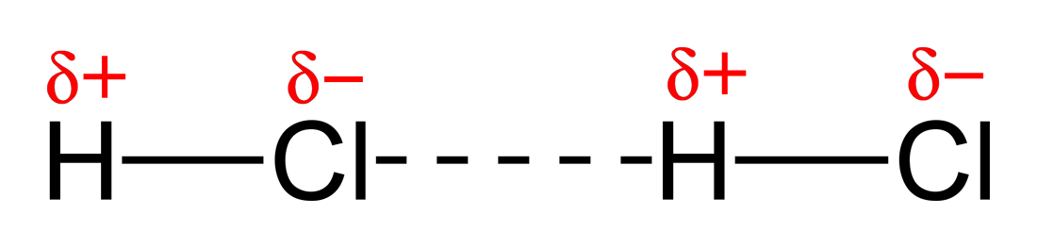
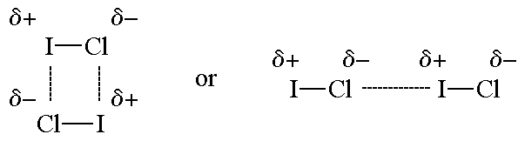
other bond dipole interactions are weaker
bond dipole interactions reach around 1-5 kJ/mole

Slide 37
For singly bonded first and second row elements bond
dipole is roughly the Δχ between the two elements.
Singly bonded first and second row elements
Bond χ₁ χ₂ Δχ bond dipole
C-H χ_{C}=2.5 χ_{H}=2.1 0.4 0.3 D
C-N χ_{N}=3.0 χ_{C}=2.5 0.5 0.5 D
N-O χ_{O}=3.5 χ_{N}=3.0 0.5 0.3 D
C-O χ_{O}=3.5 χ_{C}=2.5 1.0 1.0 D
O-H χ_{O}=3.5 χ_{H}=2.1 1.4 1.5 D
C-F χ_{F}=4.0 χ_{C}=2.5 1.5 1.4 D

Slide 38
For multiple bonded first and second row elements and
third and higher row elements.
Mulitple bonds have high dipole moments.
Third and higher rows, Δχ not too important.
Bond χ₁ χ₂ Δχ bond dipole
C-Cl χ_{Cl}=3.0 χ_{C}=2.5 0.5 1.7 D
C-Br χ_{Br}=2.8 χ_{C}=2.5 0.3 1.7 D
C-I χ_{I}=2.7 χ_{C}=2.5 0.2 1.6 D
C=O χ_{O}=3.5 χ_{C}=2.5 1.0 2.5 D
C≅N χ_{N}=3.0 χ_{C}=2.5 0.5 3.6 D

Slide 39
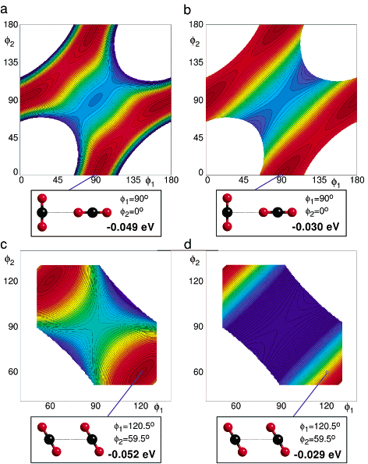
What causes two CO₂ molecules to come together as shown
below?
Carbon dioxide
has no
hydrogen bonds.
1 eV corresponds
to 100 kJ/mol

Slide 40
Bond dipole vs. hydrogen bond interactions
room temperature 2.5 kJ/mol
CO₂ melts/boils -78ºC
At 1 atm pressure CO₂
sublimes.
HCOOH melts at 8ºC
HCOOH boils at 100ºC
Why are boiling points at such different temperatures?

Slide 41
Bond dipole vs. hydrogen bond interactions
room temperature 2.5 kJ/mol
CO₂ melts/boils -78ºC
At 1 atm pressure CO₂
sublimes.
HCOOH melts at 8ºC
HCOOH boils at 100ºC
bond dipole interactions reach
around 1-5 kJ/mole
O-H ...O hydrogen bond is around 20 kJ/mol

Slide 42
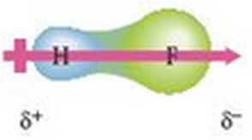
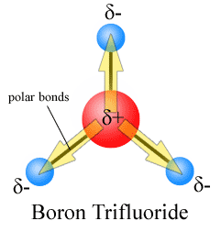
bond dipoles
molecular dipoles

Slide 43
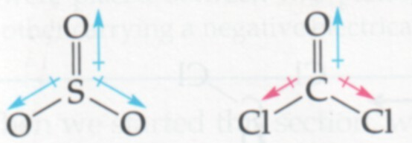
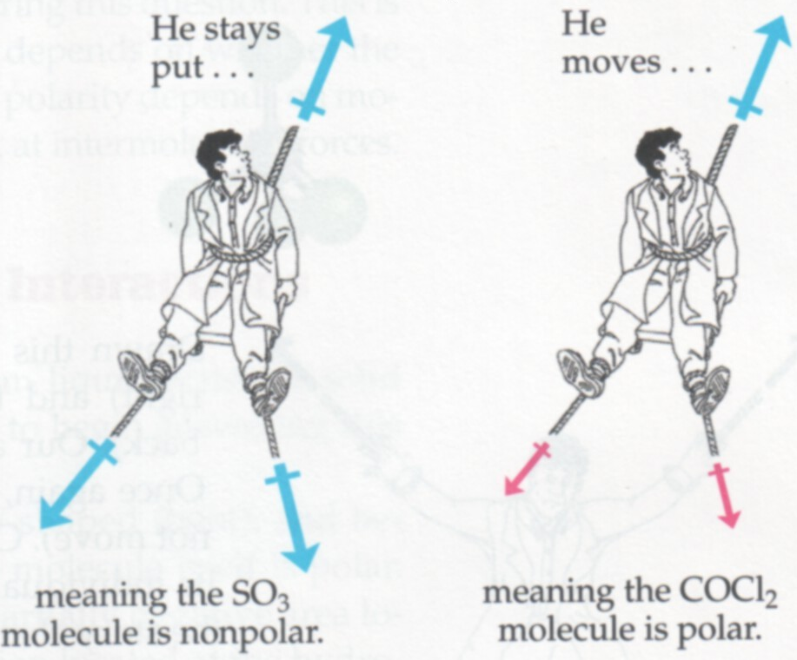
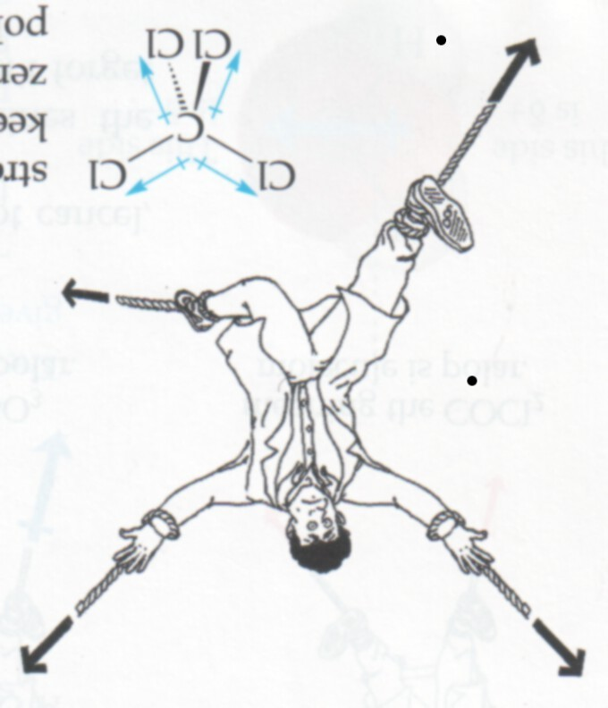
Molecular
dipole
moments

Slide 44
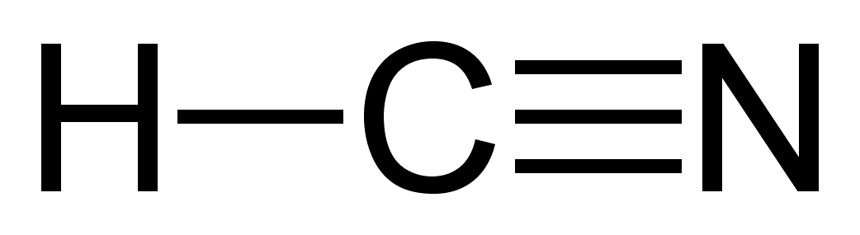
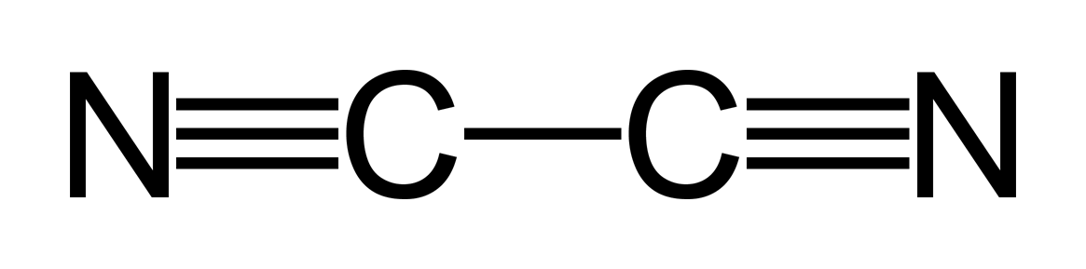


For small molecules, like CO₂ or NCCN, the
cancellation of bond dipoles in the molecular
dipole weakens the intermolecular interactions.

Slide 45
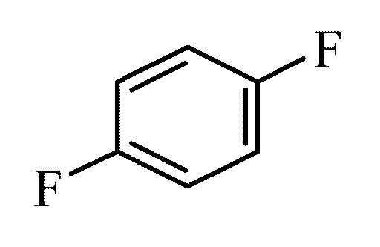
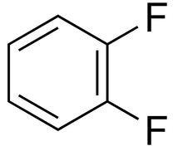
For larger molecules, as are found in organic
chemistry, the cancellation of bond dipoles in
the molecular dipole does not strongly affect
intermolecular interactions.
1,4 difluorobenzene
90 ºC boiling point
1,2 difluorobenzene
90 ºC boiling point

